Slide 1
Priority Queue {
forbeginners.html
workshop.css
[Implementation in Java]
Data Structures Project
Worked by:Joana Taraj, Sibora Hysenaj, Abigeil Zenelaj
}
Programming Language
https://github.com/jtaraj-create/JavaProject

Slide 2
01 {
[Introduction]
forbeginners.html
workshop.css
}
Programming Language

Slide 3
Concepts < /1 > {
forbeginners.html
workshop.css
< A priority queue is a type of queue where each element is associated with a priority value, and elements are served based on their priority rather than their insertion order >
}
Application < /2 > {
< CPU Scheduling
Graph algorithms like Dijkstra's shortest path algorithm, Prim's Minimum Spanning Tree, etc.
All queue applications where priority is involved.
Data compression in Huffman code
Event-driven simulation such as customers waiting in a queue.>
}
Programming Language

Slide 4
What Is this ‘Project About ?’ {
forbeginners.html
workshop.css
Objective
< The main objective of this project is to implement the basic operations of a priority queue in Java. >
The program allows users to:
Add items with priorities
Display all items in the queue
View and remove the highest priority item
}
Programming Language

Slide 5
Operations of ‘the Menu’ {
forbeginners.html
workshop.css
01
Enqueue and dequeue item
02
Peek highest priority item
03
Display queue and check its size
04
Exit program
}
Programming Language

Slide 6
Tools used on ‘The Project’{
forbeginners.html
workshop.css
OOP
Queue
< Java Programming Language>
< Custom Priority Queue Implementation>
Input
GitHub
< Scanner Class for User Input>
< GitHub for Project Management>
}
Programming Language

Slide 7
Structure of ‘the Project’ {
forbeginners.html
workshop.css
Main.java
Controls the menu and user interaction.
PriorityQueue.java
Contains the main logic for enqueue, dequeue, display, and queue operations.
QueueItem.java
Represents each item stored in the priority queue with its value and priority.
PriorityQueueTest.java
Used to test the functionality of the priority queue.
}
+README.md +sample_output.txt
Programming Language

Slide 8
How <Enqueue> works{
Code
Explanation
public void enqueue(String item, int priority) {
QueueItem newItem = new QueueItem(item, priority);
heap.add(newItem);
heapifyUp(heap.size() - 1);
}
Creates a new queue item.
Adds the item to the heap.
Calls heapifyUp() to move the item to the correct position.
Maintains priority queue order.
}
}

Slide 9
How <Dequeue> works{
Code
Explanation
public QueueItem dequeue() {
if (isEmpty()) {
throw new IllegalStateException(
"Cannot dequeue from an empty priority queue.");}
if (heap.size() == 1) {
return heap.remove(0);}
QueueItem highestPriorityItem = heap.get(0);
QueueItem lastItem = heap.remove(heap.size() - 1);
heap.set(0, lastItem);
heapifyDown(0);
return highestPriorityItem;
}
Checks if the queue is empty.
Removes the highest-priority item from the root.
Replaces it with the last item.
Calls heapifyDown() to restore heap order.
}

Slide 10
How <Peek> works{
Code
Explanation
public QueueItem peek() {
if (isEmpty()) {
throw new IllegalStateException(
"Cannot peek from an empty priority queue.");
}
return heap.get(0);
}
Returns the highest-priority item.
Does not remove the item.
The root of the heap always contains the highest priority.
}

Slide 11
How <Display> works{
Code
Explanation
public void display() {
if (isEmpty()) {
System.out.println("Priority queue is empty.");
return;}
System.out.println("Current Priority Queue:");
for (QueueItem queueItem : heap) {
System.out.println(queueItem);}
}
Checks whether the queue is empty.
Uses a loop to print all queue items.
Displays current queue contents.
}

Slide 12
How <HeapifyUp> works{
Code
Explanation
private void heapifyUp(int index) {
while (index > 0) {
int parentIndex = (index - 1) / 2;
if (heap.get(index).getPriority()
< heap.get(parentIndex).getPriority()) {
swap(index, parentIndex);
index = parentIndex;
} else {
break} }
}
Compares a child node with its parent.
Swaps them if the child has higher priority.
Moves the item upward until heap order is correct.
}

Slide 13
How <HeapifyDown> works{
Code
Explanation
private void heapifyDown(int index) {
int smallest = index;
int left = 2 * index + 1;
int right = 2 * index + 2;
if (left < heap.size() &&
heap.get(left).getPriority()
< heap.get(smallest).getPriority()) {
smallest = left;}
if (right < heap.size() &&
heap.get(right).getPriority()
< heap.get(smallest).getPriority()) {
smallest = right;}
if (smallest != index) {
swap(index, smallest);
heapifyDown(smallest);} }
Checks left and right child nodes.
Finds the smallest priority value.
Swaps nodes if needed.
Restores heap structure after removal.

Slide 14
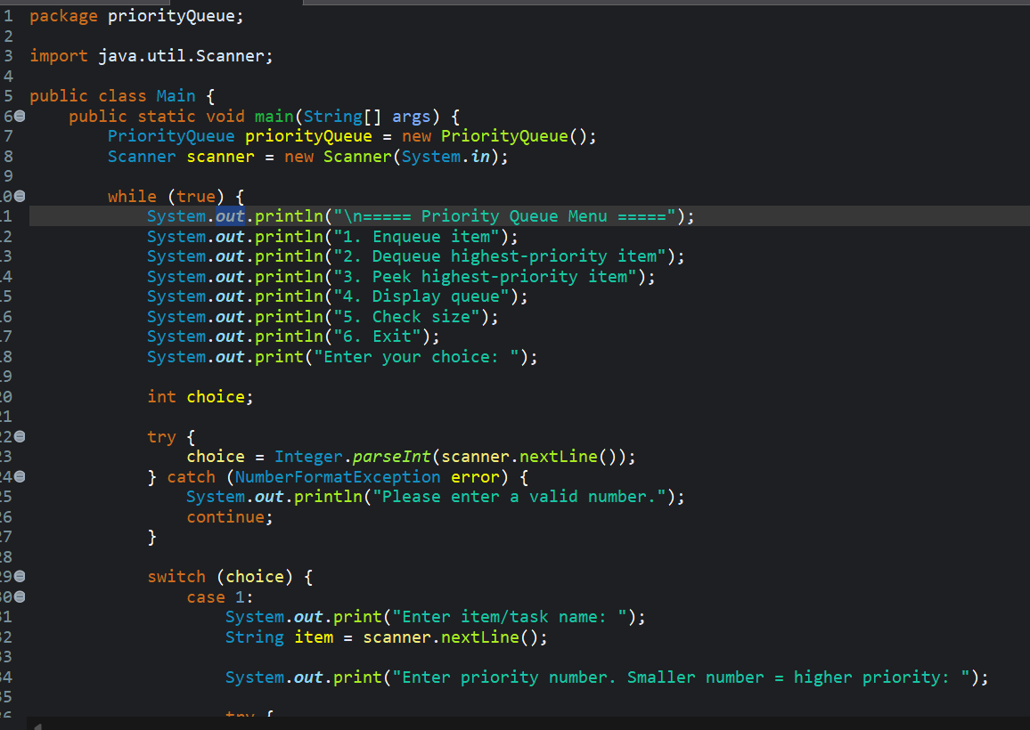
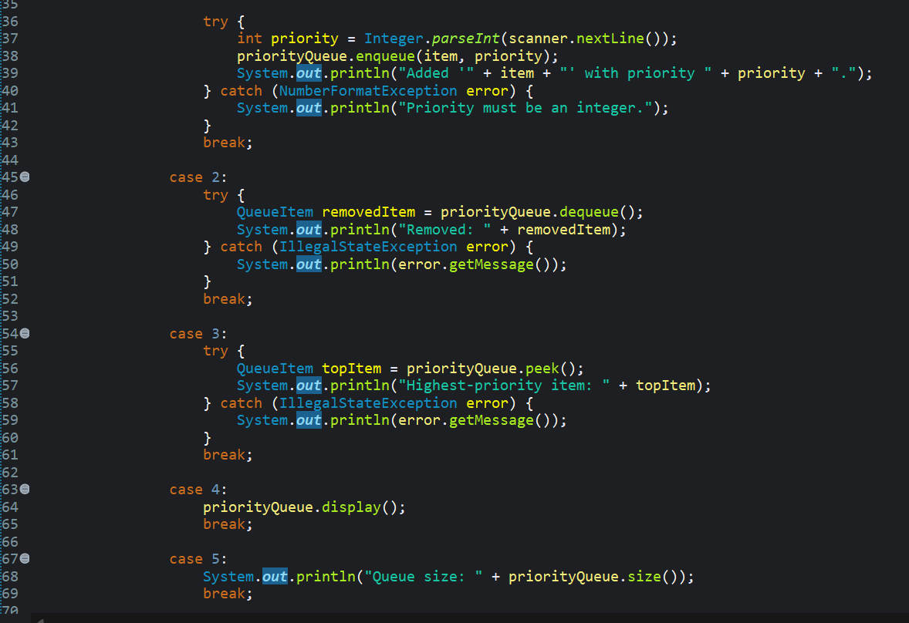
forbeginners.html
workshop.css
MAIN class
Programming Language

Slide 15
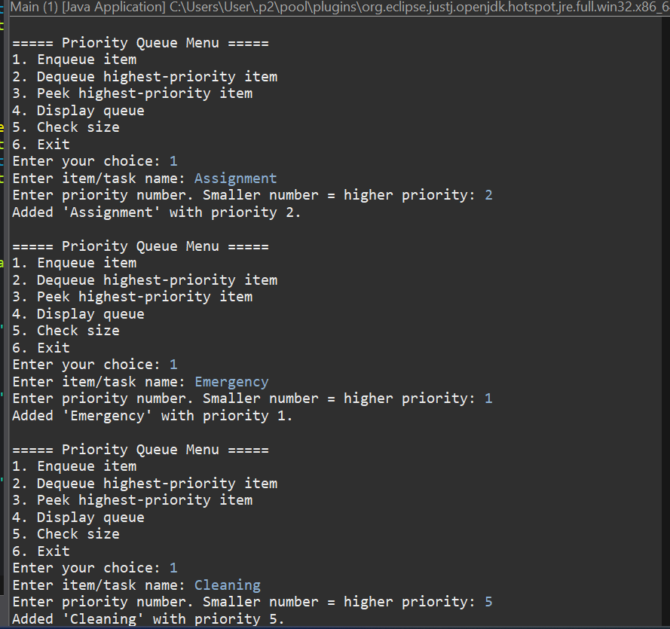
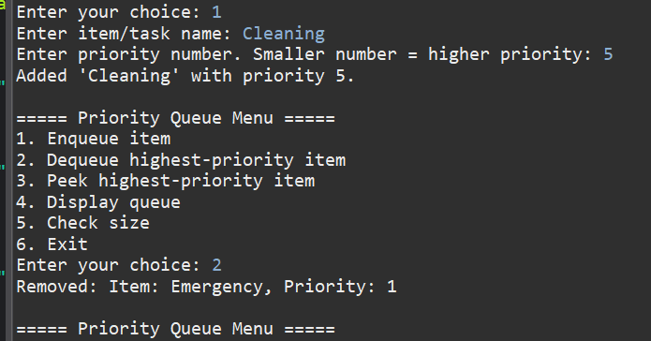
forbeginners.html
workshop.css
OUTPUT
Programming Language

Slide 16
THANK YOU!
Worked by:Joana Taraj, Sibora Hysenaj, Abigeil Zenelaj
Project GitHub link: https://github.com/jtaraj-create/JavaProject

